Slide 1

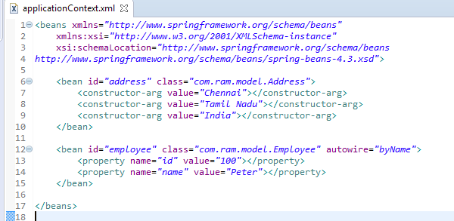
byName Auto-wiring mode in Spring
The byName Auto-wiring mode injects the object dependency according to name of the bean. In such case, property name and bean name must be same. It internally calls setter method.

